Slide 1

Introduction to Machine Learning
Basic Statistics
Necessary for ML/Data Science

Slide 2
Introduction to Statistics
<Topic>

Slide 3


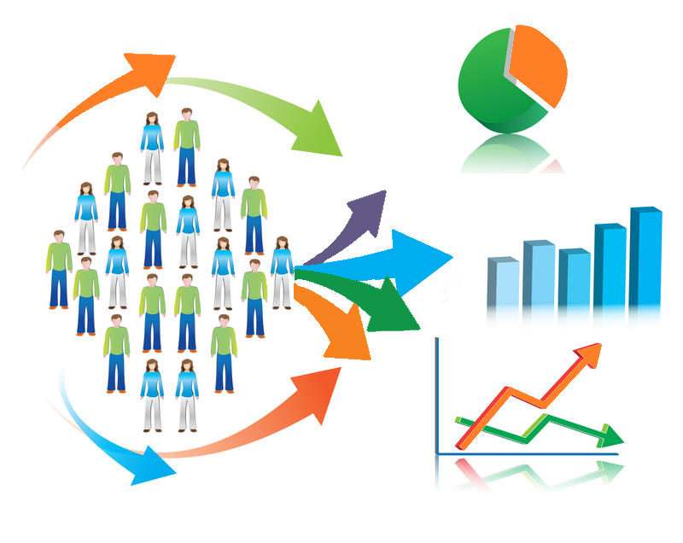
Introduction to Statistics
Why Statistics???
The key fundamental skills required for Data Science
Notes:
The first question that arise in our mind is why Statistics?
Let me make you clear that Statistics is one of the key fundamental skills required for data science. Moving forward in the data science, if you go for any kind of algorithms then primarily knowledge in statistics is quite important. Actually, the statistics and probability are considered as the base knowledge and they are very essential for moving into any machine learning algorithms.

Slide 4
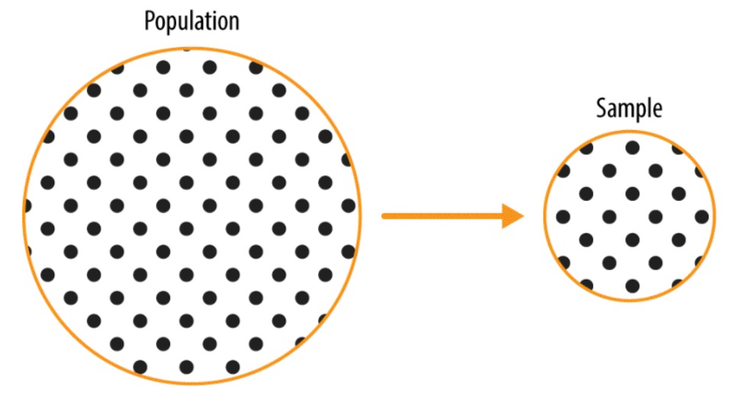
Statistical Terminology
What is Population & Sample?
A population includes all of the elements from a set of data
A sample consists one or more observations drawn from the population
Notes:
Let begin with our understanding about Population & Sample.
A population <Click Event> includes all of the elements from a set of data. so the whole data set where we have all data of our interest is define as Population.
And a sample <Click Event> consists one or more observations drawn from the population. We can also say

Slide 5
Statistical Terminology
Population
Sample
Collection of all items of interest to our study
A Subset of Population
N
n
Parameters
Statistics
Notes:
A population is the <Click Event> collection of all items of interest to our study and is usually denoted with <Click Event> an uppercase N. The numbers we’ve obtained when using a population are called <Click Event> parameters.
A sample is <Click Event> a subset of the population and is denoted with <Click Event> a lowercase n, and the numbers we’ve obtained when working with a sample are called <Click Event> statistics

Slide 6
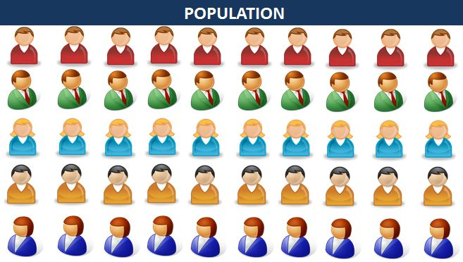
Statistical Terminology
Notes:
Let’s say we want to make a survey of the marks of 100 students, then 100 student will represent our population. From here <Click Event> if we take some data then that data will be our sample.
So how do we extract this data from population, we cannot randomly pick it.
For sampling data we have various techniques, so that we could say that this sample consist of similar data of the complete population.
In a simplified way we can say that this sample like an understandable form of the whole population data set. There are different kind of sampling techniques that we have use to extract this sample data which we can make use for any kind of analysis. And we can say that our whole population is infer in this sample and we can derive solution out of it.

Slide 7


Statistical Terminology
What is Census & Survey?
Census
Gathering data from the whole population of interest
Survey
Gathering data from the sample in order to make conclusions about the population.
Notes:
Now, we will look at what is Census and what is Survey?
Census is <Click Event> something where we gather data from the whole population of interest. For example – Elections or any 15-year census etc. can be consider as a Census data.
And Survey is <Click Event> the gathering of data from the sample in order to make conclusions about the population. For example a survey can be an opinion polls, or quality control checks in manufacturing units.
This two are very general term which we can mostly hear or see in the newspapers

Slide 8
Statistical Terminology
Sample
What is Parameter & Statistic?
Statistic
A descriptive measure of the sample
Population
Example - Sample mean, Sample variance, Sample standard deviation etc.
Parameter
A descriptive measure of the population
Example - Population mean, Population variance, Population standard deviation etc.
Notes:
We have already discussed Parameter & Statistic while discussing Population and Sample, now we will look at it in detail.
A Parameter <Click Event> is a descriptive measure of the population. Here any kind of the analysis related to population is called as parameters. Its <Click Event> example are Population mean, Population variance, Population standard deviation etc. Anything related to population data is defined as Parameters.
And <Click Event> a descriptive measure of the sample is known as Statistic. This sample data can be Sample mean, Sample variance, Sample standard deviation etc. Anything related to Sample data is defined as Statistic.

Slide 9
Statistical Terminology
What are its notations?
Sample
Population
Roman – Sample Statistic
Mean - ‾x
Variance - s²
Standard Deviation - s
Greek – Population Parameter
Mean - μ
Variance - σ²
Standard Deviation - σ
Notes:
So, how do these terminologies are actually donated?
Here the population parameter is denoted as <Click Event> µ for Mean, Sigma Square for variance and Sigma for standard deviation.
And the sample statistic is denoted as <Click Event> x bar for mean, s square for variance and s for standard deviation.
This are the standards ways to represent this terminologies so if any where you identify s or s square then you should identify it as sample statistic standard deviation and variance respectively.

Slide 10
Sampling
<Topic>

Slide 11

Sampling
What is Sampling?
Notes:
Data sampling is a statistical analysis technique used to select, manipulate and analyze a representative subset of data points in order to identify patterns and trends in the larger data set being examined. Sampling allows data scientists, predictive modelers and other data analysts to work with a small, manageable amount of data in order to build and run analytical models more quickly, while still producing accurate findings. Sampling can be particularly useful with data sets that are too large to efficiently analyze in full.

Slide 12
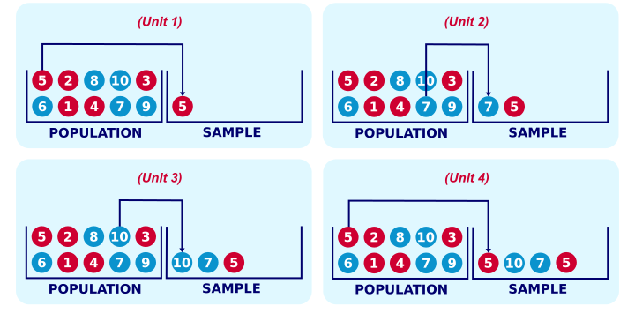
Sampling Technique
Every subject in the population has an equal chance of being selected. Randomly pick subjects from the whole population.
What is Simple Random Sampling?
SIMPLE RANDOM SAMPLING WITH REPLACEMENT
Notes:
So, what is Simple random sampling?
It is a sampling technique where <Click Event> every item in the population has an even chance and likelihood of being selected in the sample. Here the selection of items completely depends on chance or by probability and therefore this sampling technique is also sometimes known as a method of chances.
Here in the screen <Click Event> we can a textbook example of simple random sampling is sampling a marble from a vase. We record one or more of its properties, perhaps its color, number or weight and put it back into the vase. We repeat this procedure n times for drawing a sample of size n. The idea is illustrated by the figure on the screen.
When sampling the first marble, each marble has the same chance of 0.1 of being sampled. When sampling the second marble, each marble still has a 0.1 chance of being sampled. This generalizes to all subsequent marbles being sampled. Each time we sample a unit, all units have similar chances of being sampled. This is precisely what we meant with our definition of simple random sampling. Don’t you think.
Here if we look at the screen, <Click Event> it may surprise you that marble 5 occurs twice in our sample. This may happen because we need to replace each marble we sampled.
Not replacing the marbles we sampled results in simple random sampling without replacement, Let's see how that works.

Slide 13
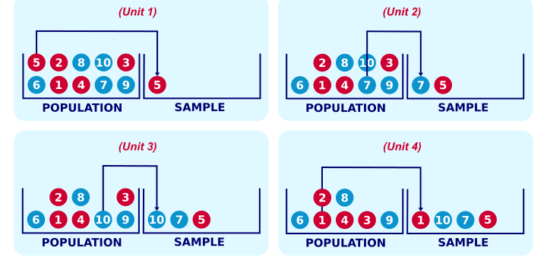
Sampling Technique
Simple Random Sampling without Replacement
SIMPLE RANDOM SAMPLING WITHOUT REPLACEMENT
Notes:
Right, for the first marble we sample, each marble has a 0.1 chance of being sampled. So far, so good. If we don't replace it before sampling a second unit, however, the first unit we sampled has a zero chance of being sampled. The other 9 units each have a chance of 1 in 9 = 0.11 of being sampled as the second unit. This is how simple random sampling without replacement violates our definition of simple random sampling. Note that this violation gets worse as we sample more units from a smaller population.

Slide 14


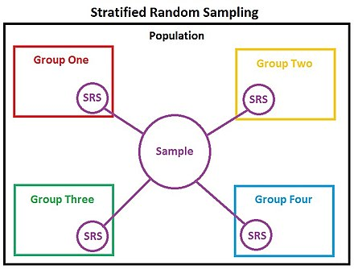
Sampling Technique
What is Stratified Sampling?
The population is partitioned into non-overlapping groups, called strata and a sample is selected by some design within each stratum
Population
Strata
Notes:
The next technique is Stratified sampling. With stratified sampling, <Click Event> the researcher divides the population into separate groups, called strata. Then, a probability sample is drawn from each group.
Let’s consider a situation <Click Event> where a research team is seeking opinions about religion amongst various age groups. Instead of collecting feedback from 326,044,985 U.S citizens, random samples of around 10000 can be selected for research. These 10000 citizens can be divided into strata according to age, that is, groups of 18-29, 30-39, 40-49, 50-59, and 60 and above. Here each stratum will have distinct members and number of members will also be distinct.

Slide 15
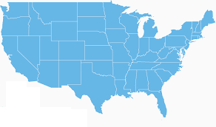
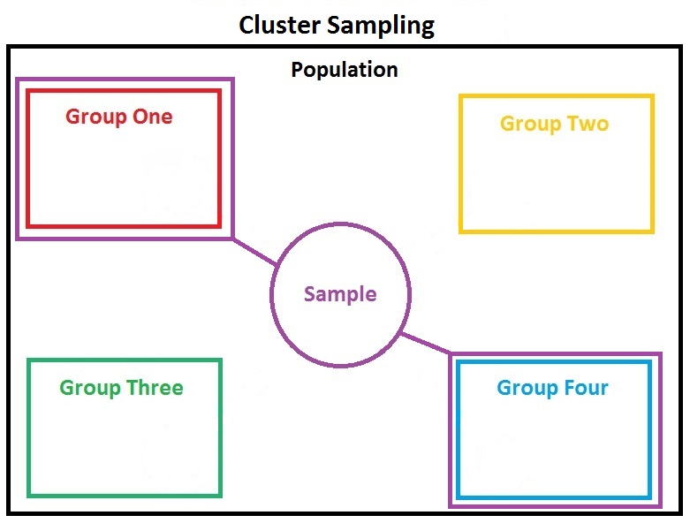

What is Cluster Sampling?
Cities with the highest population
Divide the population into groups (clusters)
Obtain a simple random sample of so many clusters from all possible clusters
Obtain data on every sampling unit in each of the randomly selected clusters
Cluster
Using mobile devices.
Notes:
Cluster sampling is a sampling technique that divides the main population into various sections (clusters). In this sampling technique, analysis is carried out on a sample which consists of multiple sample parameters such as demographics, habits, background – or any other population attribute which may be the focus of conducted research. It is usually used when groups that are similar yet internally diverse form a statistical population.
Instead of selecting the entire population of data, cluster sampling allows the researchers to collect data by bifurcating the data into small, more effective groups.
Let’s consider a scenario <Click Event> where an organization is looking to survey the performance of smartphones across USA. They can divide the entire country’s population<Click Event> into cities that is clusters, and further <Click Event> select cities with the highest population and also <Click Event> filter those using mobile devices. This multiple stage sampling is known as cluster sampling.

Slide 16
Categories of Statistics
<Topic>

Slide 17
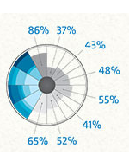
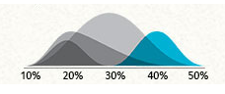
Categories of Statistics
Recall Statistics!!
Descriptive Statistics
Inferential Statistics
Notes:
As we have already discussed, Statistics is concerned with developing and studying different methods for collecting, analyzing and presenting the empirical data.
The field of statistics is composed of two broad categories <Click Event> the first category is Descriptive and <Click Event> the second category is inferential statistics. Both of them give us different insights about the data. One alone doesn’t not help us much to understand the complete picture of our data but using both of them together gives us a powerful tool for description and prediction.
let us get the basic idea of what they are?

Slide 18
Categories of Statistics
What is Descriptive Statistics?
The analysis of data that helps describe, show or summarize data in a meaningful way such that, for example, patterns might emerge from the data
Just describes and summarizes data
Notes:
So, what is Descriptive Statistics?
Descriptive Statistics is <Click Event> the analysis of data that helps to describe, show or summarize data in a meaningful way. Data can be summarized and represented in an accurate way using charts, tables and graphs. It do not allow us to make conclusions beyond the data which we have analyzed or reached conclusions. With descriptive statistics, we will not receive any uncertainty because we are describing only the people or the items that we actually wants to measure, here we are not inferring the properties of a larger population.
The descriptive statistics is actual very important because if we have not presented our data in this way then it would be very hard to visualize what the data is showing especially if there are lot of node for descriptive analytics. The descriptive statistics helps us to present the data in a more meaningful by which it allow us to make simply interpretation of the data. For example if we have marks of 1000 students and we may be interested in the overall performance of those students and the distribution as well as the spread of marks. Descriptive statistics provides us the tools to define our data in a most understandable and appropriate way.
In a nutshell, descriptive statistics <Click Event> just describes and summarizes data but do not allow us to draw conclusions about the whole population from which we took the sample.

Slide 19
Categories of Statistics
What is Inferential Statistics ?
Inferential Statistics takes data from a sample and makes inferences about the larger population from which the sample was drawn
Studies a sample of same data
Notes:
And Inferential Statistics <Click Event> is about using data from sample and then making inferences about the larger population from which the sample is drawn. The goal of the inferential statistics is to draw conclusions from a sample and generalize them to the population.
so it is very important that our sample accurately reflect the population, that the reason why sampling techniques is very important as this sample dataset reflect the whole population and then only when we are doing any kind of influential statistic like the mean of sample could be similar to the mean of the whole population and in case if our sample is not correct or not actually reflecting the whole population then if we do any kind of inferencing then that would be wrong because our sample is not reflecting the whole population.
For example, suppose we are interested in the exam marks of all the students in UK. But it is not feasible to measure the exam marks of all the students in UK. So now we will measure the marks of a smaller sample of students, that can be 1000 students. This 1000 students sample will now represent the large population of UK students. And we would consider this sample for our statistical study for studying the population from which it’s inferred. That the reason it is important that our sample should accurately represents the whole population.
Sometime, the inferential statistics is also called as inductive statistics
In a nutshell, Inferential statistics <Click Event> makes inferences about populations using data drawn from the population. Instead of using the entire population to gather the data, the statistician will collect a sample and make inferences about the entire population using the sample.

Slide 20
Skewness
<Topic>

Slide 21
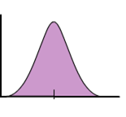
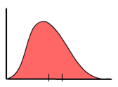
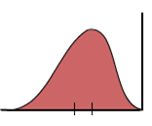
Skewness
What is Skewness?
Represents an imbalance and asymmetry from the mean of a data distribution
Notes:
Skewness in statistics represents an imbalance and asymmetry from the mean of a data distribution. <Click Event> If you look at a normal data distribution using a bell curve, the curve will be perfectly symmetrical. Now, this doesn't happen all that often! <Click Event>In order to fully understand when a data distribution is imperfect and skewed, let's look at a normal data distribution and symmetrical bell curve.

Slide 22
Skewness
Recall Mean, Median, and Mode
Mean is the average of the numbers in the data distribution
Median is the number that falls directly in the middle of the data distribution
Mode is the number that appears most frequently in the data distribution
Notes:
First, let me remind you of a few basic terms
<Click Event>Mean is the average of the numbers in the data distribution
<Click Event>Median is the number that falls directly in the middle of the data distribution
<Click Event>Mode is the number that appears most frequently in the data distribution

Slide 23
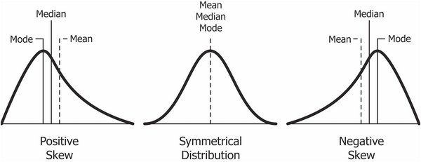
Skewness
What is Skewness?
Notes:
In a normal data distribution, the mean is directly in the middle and top point of the bell curve.

Slide 24

Skewness
$ Made | Frequency
500 | 1
1000 | 2
1500 | 3
2000 | 4
2500 | 3
3000 | 2
3500 | 1
Data Distributions, Standard Deviations, and Bell Curves
Summer Job Incomes
Notes:
Imagine that Mrs. John wanted to teach her high school statistics class on the first day about data distributions, standard deviations, and bell curves. She asks her <Click Event>16 student class to secretly divulge their summer job incomes. Each student provides Mrs. john with a piece of paper with their income. <Click Event>She rounds each income level to the nearest 500 and makes a chart.
Now that we see the data on a chart, we can see that four of the students made about $2,000 in total over the summer. If we find the mean, we see that it is $2,000. The mode and median in this data distribution also happen to be $2,000.
<Click Event>In a normal data distribution and perfectly symmetrical bell curve, the median and mean are always the same value. Take a look at the graph of the data which represents a normal bell curve so, no skewness at all!.

Slide 25
Skewness
Properties of Skewed Bell Curves
Symmetric Distribution
Skewed Distribution
Mean
Median
Mode
Mean
Median
Mode
Notes:
Now, we will look at the properties of Skewed Bell Curves
<Click Event>In a symmetric bell curve, the mean, median, and mode are all the same value. How easy is that? But <Click Event>in a skewed distribution, the mean, median, and mode are all different values. You can see this represented in this image.

Slide 26
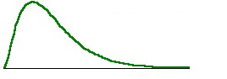
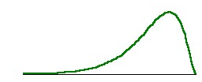
Skewness
Properties of Skewed Bell Curves
(+) Positively
Skewed Distribution
(-) Negatively
Skewed Distribution
Notes:
A skewed data distribution or bell curve can be either positive or negative. <Click Event>A positive skew means that the extreme data results are larger. This skews the data in that it brings the mean (average) up. The mean will be larger than the median in a skewed data set. <Click Event>A negative skew means the opposite: that the extreme data results are smaller. This means that the mean is brought down, and the median is larger than the mean.

Slide 27
Binomial Distribution
<Topic>

Slide 28
Binomial Distribution
What is Binomial Distribution?
A binomial distribution is a specific probability distribution. It is used to model the probability of obtaining one of two outcomes, a certain number of times (k), out of fixed number of trials (N) of a discrete random event.
Expected Outcome
Successful Outcome
p
Other Outcome
Failure
1 - p
Notes:
A binomial distribution is a specific probability distribution. It is used to model the probability of obtaining one of two outcomes, a certain number of times (k), out of fixed number of trials (N) of a discrete random event.
A binomial distribution has only two outcomes: <Click Event>the expected outcome is called a success and <Click Event>any other outcome is a failure. The probability of a successful outcome <Click Event>is p and the probability of a failure <Click Event>is 1 - p.

Slide 29
Binomial Distribution
What is Binomial Distribution?
Binomial Distribution = 2
Head = 50% Chance
Notes:
A coin flip is a great example of this, because every time you flip the coin, it has to land on either heads or tails. <Click Event>The Binomial Distribution
always means two, so think of this to remember that a binomial experiment is one in which there are two possible outcomes.
It's also important that the probability of success (represented by the symbol p) is the same for all the trials. For the coin flip, <Click Event> there is a 50% chance that it will land on heads every time you flip it, so the coin flip experiment meets this condition, too!
Finally, no matter how many trials are performed (n = the number of trials), each trial must not be affected by the outcome of any other trials. This is also true for the coin flip experiment, because each time you flip the coin, the outcome is not affected by the results of any of the previous trials.
Your coin flip experiment definitely meets all of these requirements, so now we know that it is a binomial experiment.

Slide 30
Binomial Distribution
Criteria for Using Binomial Distributions
Rule #1: There are only two mutually exclusive outcomes for a discrete random variable
Rule #2: There is a fixed number of repeated trials
Rule #3: Each trial is an independent event
Rule #4: The probability of success for each trial is fixed
Notes:
The binomial distribution is used to model the probabilities of occurrences when specific rules are met.
<Click Event> Rule #1: There are only two mutually exclusive outcomes for a discrete random variable i.e., success or failure.
<Click Event> Rule #2: There is a fixed number of repeated trials i.e., successive tests with no outcome excluded.
<Click Event> Rule #3: Each trial is an independent event (meaning the result of one trial doesn't affect the results of subsequent trials.
<Click Event> Rule #4: The probability of success for each trial is fixed (i.e., the probability of obtaining a successful outcome is the same for all trials.

Slide 31
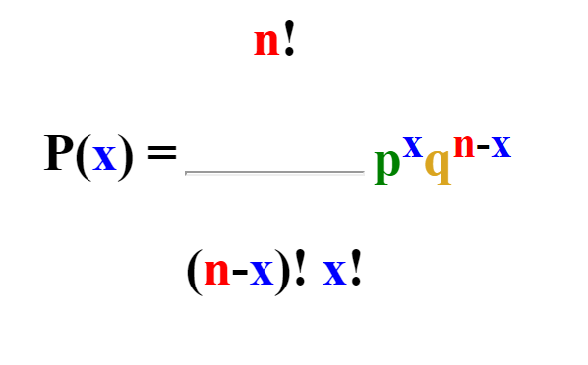
Binomial Distribution
What is Binomial Distribution formula?
The probability of getting x successes in n Bernoulli trials
This starts the count of number of ways event can occur
This is the probability of success for x trials
This is the probability of success for x trials
This ends the count of number of ways event can occur
This deletes duplications
Notes:
The probability of getting x successes in n Bernoulli trials , with the probability of success equal to p, the probability of observing exactly x successes in n independent trials
We can see the formula on screen.
Once again, n choose x tells you the number of sequences that will produce r successes in N tries, while p^{x} q^{n-x} tells you what the probability of each individual sequence is.

Slide 32
Geometric Distribution
<Topic>

Slide 33

Geometric Distribution
What is Geometric Distribution?
The geometric distribution represents the number of failures before you get a success in a series of Bernoulli trials
f(x) = (1 − p)^{x − 1}p
Notes:
The geometric distribution represents the number of failures before you get a success in a series of Bernoulli trials. This discrete probability distribution is represented by the probability density function:
<Click Event> f(x) = (1 − p)^{x − 1}p
For example, <Click Event> you ask people outside a polling station who they voted for until you find someone that voted for the independent candidate in a local election. The geometric distribution would represent the number of people who you had to poll before you found someone who voted independent. You would need to get a certain number of failures before you got your first success. If you had to ask 3 people, then X=3; if you had to ask 4 people, then X=4 and so on.

Slide 34
Normal Distribution
<Topic>

Slide 35


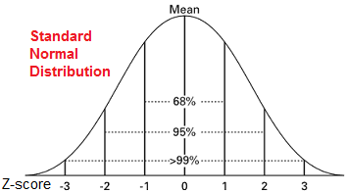
Normal Distribution
What is Normal Distribution?
84th percentile or above
95% of the lithium ion batteries
Notes:
Jane is about to take an test. The school she is applying for gives priority to candidates whose test scores are in the 84th percentile or above. Jane wonders what she should score on the test to achieve this.
<Click Event> Sam is designing an . To design it properly, he needs to know how long 95% of the lithium ion batteries will last.
What do these questions have in common? They can be solved with a greater understanding of <Click Event> the normal distribution. The normal distribution is a continuous distribution of data that has the shape of a symmetrical bell curve. It's also known as the Bell Curve.
So, what's so special about this curve? A lot of data in nature have this shape when compiled and graphed. For example, heights and weights of men and women have this distribution. Standardized test scores are normally distributed. Sometimes lifespans of manufactured parts or equipment form a normal distribution.

Slide 36
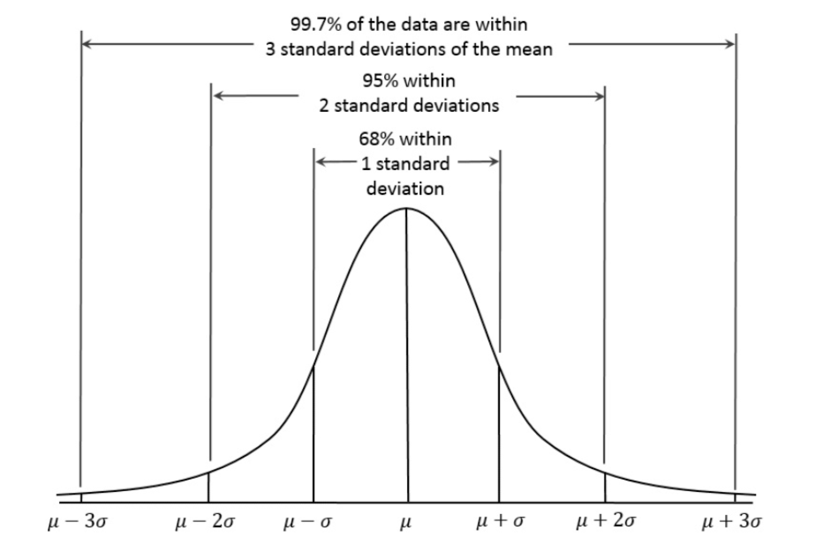
Normal Distribution
Symmetric bell shape
Mean and median are equal;
The area under the normal curve is equal to 1.0.
Normal distributions are denser in the center and less dense in the tails.
68% of the area of a normal distribution is within one standard deviation of the mean.
Approximately 95% of the area of a normal distribution is within two standard deviations of the mean.
Features of Normal Distributions
Notes:
Some of the features of normal distributions are:
<Click Event> Normal distributions are Symmetric bell shape and are symmetric around their mean.
<Click Event> The mean, median, and mode of a normal distribution are equal. All three are located at the center of the distribution.
<Click Event> The area under the normal curve is equal to 1.0.
<Click Event> Normal distributions are denser in the center and less dense in the tails.
<Click Event> Normal distributions are defined by two parameters, the mean (μ) and the standard deviation (σ).
<Click Event> 68% of the area of a normal distribution is within one standard deviation of the mean.
<Click Event> Approximately 95% of the area of a normal distribution is within two standard deviations of the mean.
The last two points means the Standard Normal curve, <Click Event> shown here, has mean 0 and standard deviation 1. If a dataset follows a normal distribution, then about 68% of the observations will fall within of the mean , which in this case is with the interval (-1,1). About 95% of the observations will fall within 2 standard deviations of the mean, which is the interval (-2,2) for the standard normal, and about 99.7% of the observations will fall within 3 standard deviations of the mean, which corresponds to the interval (-3,3) in this case. Although it may appear as if a normal distribution does not include any values beyond a certain interval, the density is actually positive for all values, . Data from any normal distribution may be transformed into data following the standard normal distribution by subtracting the mean and dividing by the standard deviation .

Slide 37
Central Limit Theorem
<Topic>

Slide 38
Central Limit Theorem
What is Central Limit Theorem?
The Central Limit Theorem states that the sampling distribution of the sample means approaches a normal distribution as the sample size gets larger — no matter what the shape of the population distribution.
This fact holds especially true for sample sizes over 30.
Notes:
The Central Limit Theorem (CLT) is a statistical theory states that given a sufficiently large sample size from a population with a finite level of variance, the mean of all samples from the same population will be approximately equal to the mean of the population.
It tells us that,
The Central Limit Theorem is exactly what the shape of the distribution of means will be when we draw repeated samples from a given population. Specifically, as the sample sizes get larger, the distribution of means calculated from repeated sampling will approach normality.
So if samples of size n are drawn randomly from a population that has a mean µ and a standard deviation of sigma, the sample means, <Click Event> are approximately normally distributed for sufficiently large sample sizes (n > 30) regardless of the shape of the population distribution.

Slide 39
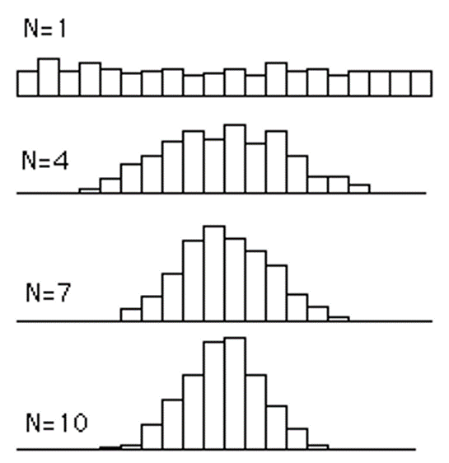
Central Limit Theorem
What is Central Limit Theorem?
When n increases: 1. the distributions becomes more and more normal. 2. the spread of the distributions decreases.
Notes:
For example, the resulting frequency distributions each based on 500 means. For n = 4, 4 scores were sampled from a uniform distribution 500 times and the mean computed each time. The same method was followed with means of 7 scores for n = 7 and 10 scores for n = 10.
<Click Event> When n increases the distributions becomes more and more normal. And the spread of the distributions decreases.

Slide 40
Probability
<Topic>

Slide 41

Probability
What is Probability?
Probability can be determined post conducting a thought experiment
P$\left(E\right)=\frac{\# of times an event occured}{total \# of opportunities for the event to have occurred}$
Notes:
Probability seeks to answer the question, "What is the chance of an event happening?" An event is some outcome of interest. To calculate the chance of an event happening, we also need to consider all the other events that can occur. As we can see in the formula Probability of an event happening that is P(E) is equal to times of an event occurred divided by total number of opportunities for the event to have occurred, which means number of ways it can happen divided by total number of outcomes.

Slide 42



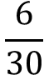
Probability
Probability Example
= 14
= 5
= 5
= 6
Total = 30
$$\frac{6}{30}$$
$$\frac{1}{5}$$
Probability =
=
Notes:
Let's look at an example of Probability. <Click Event> Emma owns a large fish store with many colors of fish. She keeps all of the fish in a large aquarium. In her main aquarium, she has 5 Orange fish, 6 Purple fish, 14 Blue fish and 5 green fish. A customer comes into the store and wants to buy a Purple fish to take home. What is the probability that Emma will reach in and scoop out a Purple fish on his first scoop?
To calculate this probability, Emma needs to find out the total number of fish in his aquarium. Emma needs to add the <Click Event> 5 Orange fish + 6 Purple fish + 14 blue fish + 5 green fish which is equal to <Click Event> 30 total fishes. Emma must also know the number of favorable outcomes. In her tank, there are only six Purple fish. So her number of favorable outcomes is six.
The formula to calculate the probability is the number of favorable outcomes over the number of total outcomes. T<Click Event> he number of favorable outcomes is six and the number of total outcomes is 30, so, the probability of Emma scooping a Purple fish the first time is 6 out of 30. Remember, all fractions must be in simplest form, so 6 over 30 will reduce to 1 over 5. The probability that Emma will scoop out a Purple fish <Click Event> on his first try is 1/5.

Slide 43
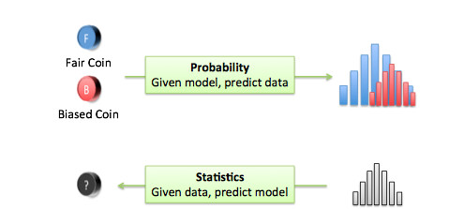
Probability vs Statistics
Probability
Statistics
What will happen in a given ideal world
Analyze the past events
How ideal is the world?
Predict the likelihood of future event
Notes:
Probability deals with predicting the likelihood of future events, while statistics involves the analysis of the frequency of past events.
Probability is primarily a theoretical branch of mathematics, which studies the consequences of mathematical definitions. Statistics is primarily an applied branch of mathematics, which tries to make sense of observations in the real world.

Slide 44


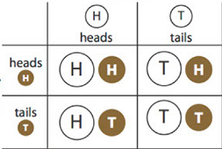
Probability Terminology
Probability Key Terms
Experiment
A test to see what will happen incase you do something.
Outcome
Refers to a single (one) result of an experiment.
Event
The set of a group of different outcomes of an experiment.
The total number of all the different possible outcomes of a given experiment.
Sample Space
Notes:
An experiment in probability <Click Event> is a test to see what will happen incase you do something. <Click Event> A simple example is flipping a coin. When you flip a coin, you are performing an experiment to see what side of the coin you'll end up with.
<Click Event> An outcome in probability <Click Event> refers to a single (one) result of an experiment. In the example of an experiment, <Click Event> one outcome would be heads and the other would be tails.
<Click Event> An event in probability <Click Event> is the set of a group of different outcomes of an experiment. Suppose you flip a coin multiple times, <Click Event> an example of an event would the getting a certain number of heads.
<Click Event> A sample space in probability <Click Event> is the total number of all the different possible outcomes of a given experiment. <Click Event> If you flipped a coin once, the sample space S would be given by: If you flipped the coin multiple times, all the different combinations of heads and tails would make up the sample space. A sample space is also defined as a Universal Set for the outcomes of a given experiment.

Slide 45
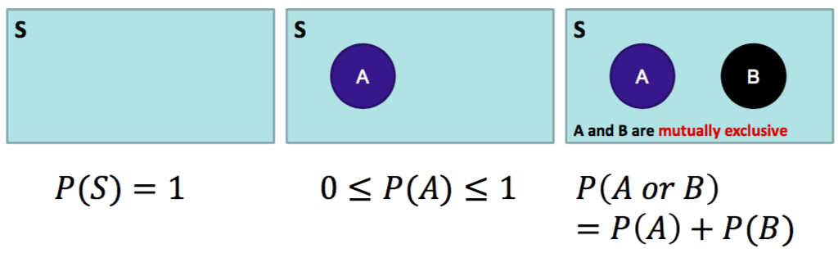
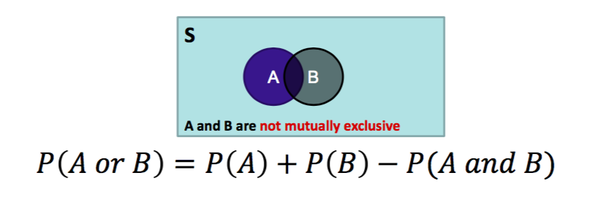
Probability Rules
Which Probability Rules are important?
Notes:
Here, this is the <Click Event> total sample space we have and the probability of this area is 1. Here, <Click Event> if any event occur then probability of an event lies between 0 and 1. If an event is certain to occur it will have a probability of 1, and if there is no chance of the occurrence of an event then the probability will be 0. here, area of the rectangle denotes sample space. Since, probability is associated with area, it cannot be negative.
Now, we will look at what is <Click Event> Mutually Exclusive event? Here, they cannot occur at the same time, if event A occurs, then event B cannot. So, if A and B are mutually exclusive events then the probability of A and B happening together is zero. Here the probability that A or B will occur is the sum of the probability of each event. That is P(A or B) = P(A) + P(B)
There is a possibility that <Click Event> if event A and B are not mutually exclusive, then then we will be removing this intersection part. So, when they are mutually exclusive to calculate probability we are just adding event A and B. and when they are not mutually exclusive then to calculate the probability of A or B equals the probability of A plus the probability of B minus the probability of A and B

Slide 46
Probability Rules
What are Independent Events?
Outcome of event B is not dependent on the outcome of event A.
P(A and B) = P(A) * P(B)
Notes:
Now, two events are known to be independent events <Click Event> if occurrence of one event will have no effect on the probability of the other one. If A and B are two independent events, and P(A) and P(B) be their probabilities then independent probability rule of multiplication is, <Click Event> Probability of both A and B occurring, P(A and B) = P(A) × P(B)
For example <Click Event> the probability of rolling a dice and getting a 2 for the first time and for the second time. Those events are independent.

Slide 47
Probability Categories
Probability Categories
Frequent
Find the chance of a
particular outcome
Probability
Conditional
Measures the probability of an
event if another event has
already occurred
Notes:
Mainly, <Click Event> the probability can be defined in two categories - <Click Event> frequent and <Click Event> conditional probability.
A Frequent probability is <Click Event> used to find the chance of a particular outcome. Tossing a fair coin with the outcome of tail as 1 otherwise head occurring at a time will be 0. Suppose if we repeat this experiment 1000’s time and counted each result and after completing this experiment we received the outcomes as 600 times tails means 1’s and 400 heads as 0’s. And if we count how frequent the heads or tails have come in the past then we will get result as 60% tail and 40% heads. This frequency can be consider as probabilities for fair coin coming up as head or tails and this is the Frequent probability.
And conditional probability of an event <Click Event> is measures the probability of an event if another event has already occurred. In other words, we can say that conditional probability of an event is the probability of that event given that another event has already taken place before it. Let A and B be two events associated with an experiment.
Then the occurrence of B is restricted by the fact that A will have occurred before B and will affect B.

Slide 48

Probability Categories
Conditional Probability
P(B|A) = $\frac{\text{P}\text{(}\text{A}\text{∩}\text{B}\text{)}}{\text{P}\text{(}\text{A}\text{)}}$
or P(A∩B) = P(A)P(B|A)
Notes:
So the condition of occurrence of B given that A has taken place is written as A∩B and this probability is written P(B|A), notation for the probability of B given A.

Slide 49


Probability Categories
Conditional Probability
“Given that event B has already occurred, what is the probability of A?”
Notes:
Let’s consider two events, A and B: A as <Click Event> it rains and B as <Click Event> a Little League game is cancelled.
From these definitions, you might quickly realize that the two events are not mutually exclusive; that is, both A and B could occur simultaneously. Also, the two events are likely not independent of one another; that is to say, if event A occurs that is it rains, will likely impact the probability of B occurring that is the event of rain will greatly increase the likelihood that the Little League game is cancelled.
So, what is the probability that the Little League game is cancelled, given that it rains today? This probability is called a conditional probability, because we are given the condition that it is raining. In other words, event B is no longer a “what if”—we know that it has occurred, and it may or may not have an impact on the probability of event A. Therefore, <Click Event> “Given that event B has already occurred, what is the probability of A?” is a conditional probability.

Slide 50
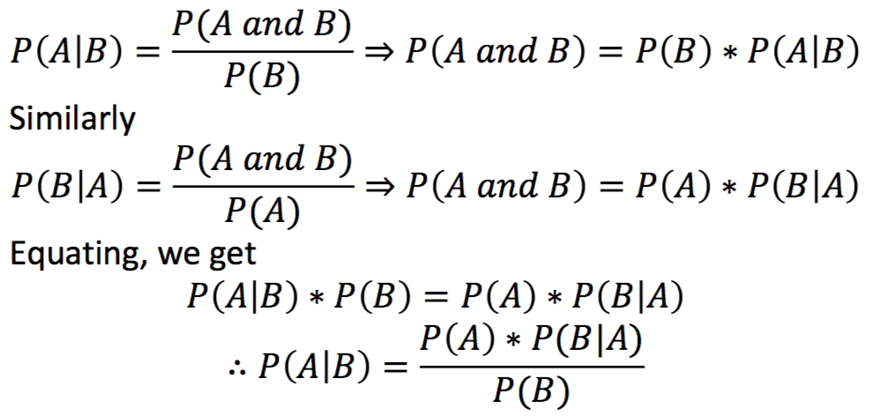
Probability Categories
Formula for Conditional Probability
Notes:
Here are the formula for conditional probability.
<Click Event>The conditional probability of A given B is denoted by P(A|B) = P(A and B) divided by P(B), here, P(B) > 0. and if we want to cross multiply probability of A and B then Probability of A and B = P(B)* P(A|B)
<Click Event>Similarly, the conditional probability of B given A is denoted by P(B|A) = P(A and B) divided by P(A), here, P(B) > 0. and if we want to cross multiply probability of A and B then Probability of A and B = P(A)* P(B|A)
And later <Click Event>when we equate this two equations then, P(A|B) * P(B) is equal to P(B|A) * P(A)
From here<Click Event> if we are moving P(B) down here, then P(A|B) is equal to P(B|A) * P(A) divided by P(B)
And this is the base theorem of conditional probability.

Slide 51
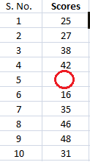
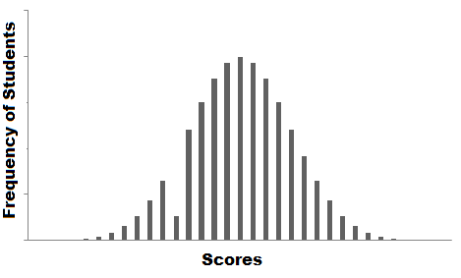
Probability Distribution
What is Probability Distribution?
The probability function for a discrete random variable is the probability mass function. It shows the exact probabilities for a particular value of the random variable.
Notes:
The probability function for a discrete random variable is the probability mass function. It shows the exact probabilities for a particular value of the random variable.
Suppose you are a teacher in a university. After checking assignments for a week, you graded all the students. You gave these graded papers to a data entry guy in the university and tell him to create a spreadsheet containing the grades of all the students. <Click Event> But the guy only stores the grades and not the corresponding students.
He made another blunder, he missed a couple of entries in a hurry and we have no idea whose grades are missing. Let’s find a way to solve this.
<Click Event> One way is that you visualize the grades and see if you can find a trend in the data.
The graph that you have plot is called the frequency distribution of the data. You see that there is a smooth curve like structure that defines our data, <Click Event> but do you notice an anomaly? We have an abnormally low frequency at a particular score range. So the best guess would be to have missing values that remove the dent in the distribution.
This is how you would try to solve a real-life problem using data analysis. For any Data Scientist, a student or a practitioner, distribution is a must know concept. It provides the basis for analytics and inferential statistics. While the concept of probability gives us the mathematical calculations, distributions help us actually visualize what’s happening underneath.
We have different types of Distributions like Bernoulli Distribution, Binomial Distribution, Normal Distribution, Exponential Distribution etc. we will discuss each of them later in the upcoming modules.

Slide 52


Thank You

